Slide 1
Housing policy challenges in Australia and the UK
Australia-UK housing research network meeting, 26 Sep 2024
Mark Stephens and Hal Pawson

Slide 2
Presentation outline
1. Background and context
  Housing policy governance (Hal)
  Housing market structure (Mark)
2. Key policy challenges – Australia (Hal)
  Supply
  Rental regulation reform
  Multi-unit building construction quality
3. Key policy challenges – UK (Mark)
  Supply
  Rental regulation reform
  Building safety/ Grenfell

Slide 3
1. Background and context

Slide 4
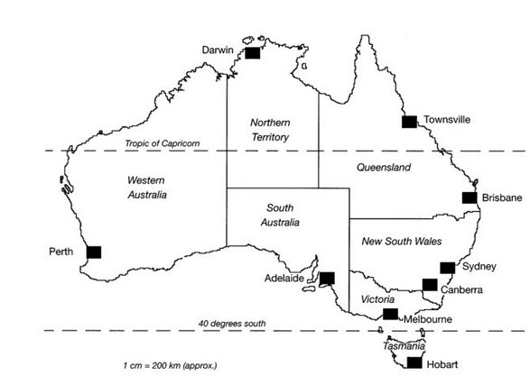
Housing policy governance – Australia (1)
Federal state with three levels of govt:
‘Commonwealth of Australia’ – relevant powers incl: income and company taxation, social security, financial regulation, migration
6 states, 2 territories – responsible for planning and housing delivery
566 local govts – ‘roads, rates and rubbish’ – no housing powers or responsibilities

Slide 5
Housing policy governance – Australia (2)
Aus Constitution (S51) specifies competencies of Commonwealth Govt – other policy areas by default responsibility of state/territory govts
Thus, S/T govts hold powers on social housing policy and delivery, private rental regulation, building standards and multi-unit housing governance regulation
Commonwealth lack of direct power to legislate on housing means no legal leverage over state/territory govts on housing matters
But CG played important national role 1945-96, centred on funding (state-provided) public housing
Post-1996, Commonwealth largely withdrew from national housing policy leadership role – albeit continuing to preside over indirectly crucial powers
2024 debate on legislating CG responsibility to develop/maintain ‘National Housing and Homelessness Plan’

Slide 6
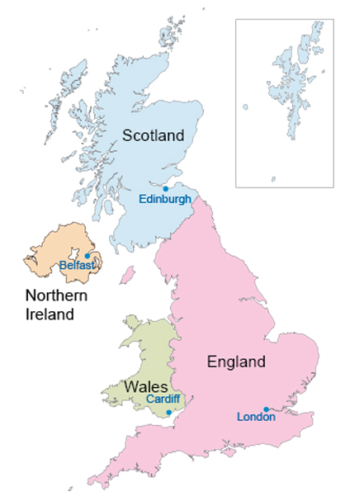
Housing policy governance – UK (1)
UK – fundamentally more centralised framework but recent evolution towards ‘quasi-federal state’
Direct housing policy powers devolved to elected govts in Wales, Scotland, N. Ireland from 1999 – incl:
  Social housing policy and funding
  Homelessness policy framework
  Rental regulation
But crucial indirect housing powers largely/wholly retained by ‘Westminster Govt’ – incl. social security, income tax, landuse planning framework
Tradition of national housing policy statements/strategies via periodic govt White Papers

Slide 7
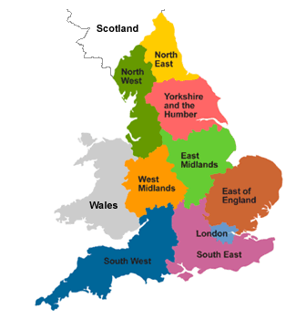
Housing policy governance – UK (2)
Governmental powers held by UK Govt by default, rather than by state/territory govts by default as in Aus
371 local govts in Eng, Wales, Scot hold important housing/homelessness and planning powers and duties
Statutory responsibility for councils to prevent, relieve and resolve homelessness
  Around half of councils handed over all ‘council housing’ to housing assocs 1989-2010
  In these areas, homelessness rehousing duties accommodated via ‘HA nominations’

Slide 8
Housing policy governance in Aus and UK: some other key commonalities
Vertical fiscal imbalance – national govt has lion’s share of tax raising and borrowing powers, plus currency issuing power, but service delivery duties mainly held by lower tiers of govt
  E.g. in Aus 81% of tax revenue collected by Commonwealth Govt, but states responsible for delivery of health, education, housing services
National govt housing minister portfolio generally accorded low status and/or subject to rapidly revolving door
Housing ‘domain knowledge’ in govt (and UK local govt) badly hollowed out in recent decades

Slide 9
Housing market structure
Both countries “homeownership societies”
  “Pricing out” began sooner in AU.
  Opposite movements on mortgaged/ outright ownership in last 20 years.
Both seen growth in PRS, but AU sector larger:
  Lightly regulated, small-scale landlords.
  Shifts towards regulation in UK in advance of AU
  Nascent BtR sectors
UK has substantially larger SRS, allowing stronger “safety net” role.
UK has substantially larger housing allowance

Slide 10
2. Key policy challenges – Australia

Slide 11
‘Housing supply’ (1)
‘Housing unaffordability’ concerns ramped up post-pandemic
Inflationary take-off during COVID-19
Only briefly dampened by sharply higher mortgage rates 2022-24
Political and media consensus:
  ‘Unaffordable housing’ largely due to ‘inadequate supply’ (plus ‘excessive immigration’)
  Former entirely results from ‘excessively restrictive land-use planning’
Sources: ABS, RBA

Slide 12
‘Housing supply’ (2)
Sharply declining residential construction approvals post-2021
  Currently 26% below required output to meet officially pledged 2024-29 target – ‘1.2 million new homes in 5 years’
Multi-unit (apartment) construction 2023-24 down 43% on 2015-19 norm, houses down 9%
Constrained industry capacity: surge of building company failures
  Builder insolvencies to Feb 24 up 76% on decade norm
Building materials supply chain constraints and v high construction cost inflation 2022-24 – only now moderating
Source: ABS

Slide 13
Rental regulation reform (1)
Private rental accommodates some 29% of Aus households
Growing no. of long term (private) renters
Liberal market regulation frameworks established by state/territory govts 1980s
Growing calls for stronger tenants rights in 2010s – key demands:
  Outlaw ‘no grounds’ evictions
  Tenant right to pet ownership by default
  More clearly defined min property condition standards
2022-24 emergence of rent regulation demands, triggered by unprecedented rent inflation (advertised rents up by 51%, nationally, 2020-24 (SQM))

Slide 14
Rental regulation reform (2)
Significant rental regulation reforms in several state/territory jurisdictions late 2010s/early 2020s (e.g. in ACT, Victoria)
Some inspiration drawn from Scottish Govt 2015 reforms
Typically includes restricting no grounds evictions, introducing pet ownership rights
Further progression possibly aided by Commonwealth Govt pledge to facilitate rental regulation ‘harmonisation’ 2023
Australian Greens party forthrightly advocating for ‘2 year national rent freeze’ and ‘rent increase restrictions’ 2022-24
Strongly resisted by Commonwealth and (most) state/territory govts

Slide 15

Multi-unit building construction quality
Consumer confidence in multi-unit building quality badly damaged by high profile structural failures late 2010s/early 2020s
Part of much wider ‘building defects’ problem – esp Syd/Melb – typically water-proofing failures
Problems generally attributed to:
  Influx of new builders in 2010s multi-unit building boom
  Legacy of progressive building control de-regulation over decades
Purposeful NSW Govt response in strengthened regulation from 2019

Slide 16
3. Key policy challenges – UK

Slide 17
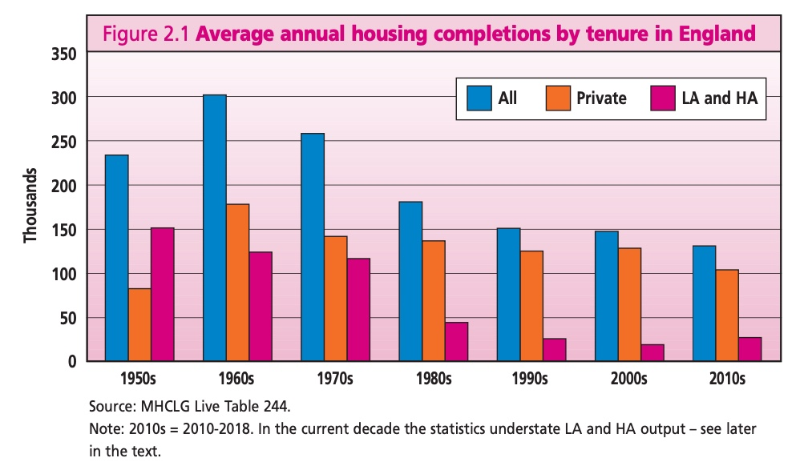
Housing Supply (1)
(England)
Long-term decline in supply
Long-term decline in housing completions which peaked in 1960s.
Main cause of reduction = social sector decline
But private output also declined to as low as ca. 100,000 units p.a. in 2010s.
2017-21 UK’s building rate per 100,000 = 246 (776 in AU).
Narrative
Inadequate supply primary cause of unaffordability.
Planning identified as the principal problem.
Conservative government (2016-24) sought to shift to zonal system and reintroduce targets.
Abandoned mandatory targets after by-election loss – but retained ambition of 300k pa.
Output fell further with interest rate hike.
Alternative views
Role of monetary policy in HP rises.
Building sector supported by Help to Buy.
Speculative housebuilders “drip feed” properties onto market.
Evidence of price sharing.
Decline in SME housebuilding sector which build out more quickly.
Neglect of social / affordable housing.

Slide 18
Housing Supply (2) (England)
The new Labour Government (elected July 2024)
Prioritised housebuilding – 1.5m units in 5 years (for GROWTH)
Implies raising “net additions” from 255k to 350k by 2029/30.
Reintroduced mandatory targets
Reviewing National Planning Framework – “how” not ”if”
Build on “grey belt” (within green belt)
Reform of Compulsory Purchase – remove “hope” value.
Greater use of land value capture
New generation of new towns
Big questions about other barriers: labour, materials, etc.

Slide 19
Private Rental Sector Regulation (1)
UK had highly liberalized PRS from 1989 – no security on most tenancies; market rents.
Now houses ca. 20% English households, inc. >30% lone parents, 19% couples with children.
Tenure shift (from homeownership and social rent) a factor in rising poverty after housing costs.
Possession claims risen rapidly since pandemic.
Case for reform irresistible.

Slide 20
PRS Regulation (2)
Scotland moved first
Open-ended tenancies from 2017.
2017 “no fault” evictions limited to sale or landlord moving in.
In 2022 all mandatory grounds for eviction ended.
Rent freeze/ cap 2022-24.
Rent Control Areas in Housing Bill.
Wales
Increased notice periods so tenants should always have 12 months’ security.
Consultation on rent control.

Slide 21
PRS Regulation (3)
England
Labour govt published Renters’ Right Bill to pick up outgoing govt’s Bill to limit “no fault evictions” to sale and landlord moving in.
Decent Homes Standard extended to PRS
Ban on rent bidding
No rent controls.

Slide 22

High rise safety & social housing regulation
Grenfell Tower Inquiry
Fire caused deaths of 73 people in 2017
Multiple failures by range of agencies/ organisations.
Shift from detailed statutory building regulations to skeleton statutory framework supported by (ambiguous) “guidance”.
UK Govt failed to act on coroner’s recommendations on earlier fatal cladding fire.
Rigged fire tests/ mis-selling by the three suppliers of cladding and insulation.
Failure of (privatised) enforcement regime.
Poor quality of renovation work -> fire not contained.
Housing management culture of ignoring tenants - & ignored 2 reports on fire safety.
London Fire Brigade training and operational failures; “stay put” policy failed.
Thousands of buildings still have dangerous cladding.
Social housing regulator given more powers, in context of wider concerns about housing management.

Slide 23
Conclusions – What should we be discussing?
Government supply councils and housing targets
Taxation of housing, land and property
Planning and Housing Supply
Housebuilding and development industry
Build to Rent (BtR)
Student housing
The scope for “affordable” housing
Energy efficiency and health
Housing and central banks

